Slide 1
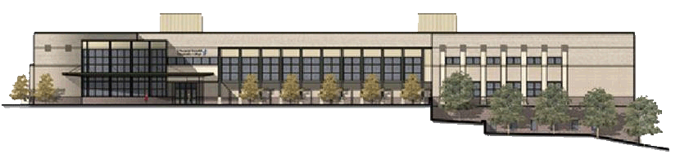
From Library to Learning Commons: Planning and Designing for Success at JSRCC
Dr. Abdul Miah, Director (amiah@reynolds.edu)
Ms. Hong Wu, Coordinator (hwu@reynolds.edu)
J. Sargeant Reynolds Community College Libraries

Slide 2
Introduction
Charge from Dr. Gary Rhodes
Research & Report
12-month research on library of the future
60-page report on future library trends
Choose Learning Commons as our model
JSRCC Library Learning Commons

Slide 3
We have achieved the three basic principles we envision of a Learning Commons:
Inviting and Comfortable, like a home away from home
Encouraging collaboration, communication and congregation
Meeting the high tech needs of the net generation

Slide 4
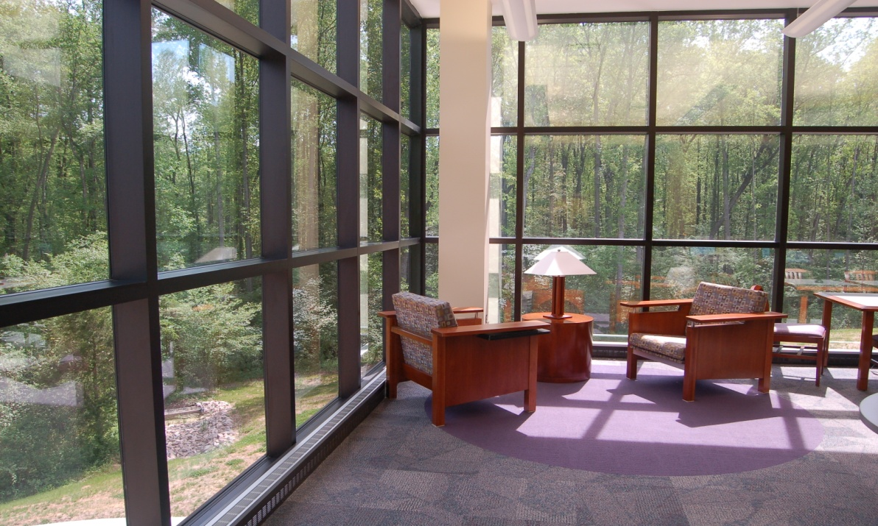
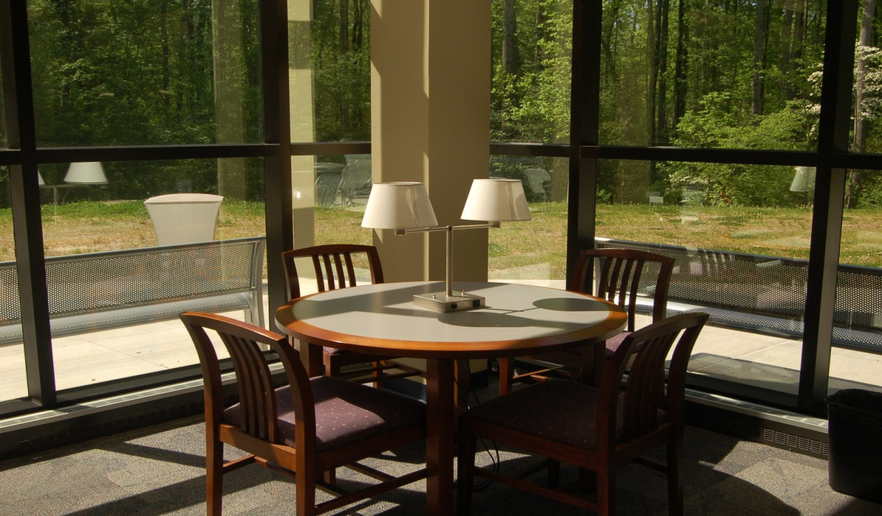
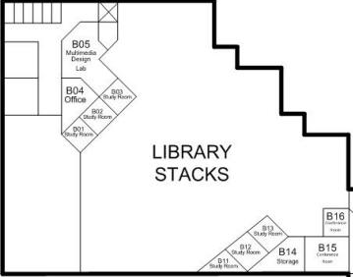
Inviting : Floor to ceiling glass window presents a panoramic view to the nature

Slide 5
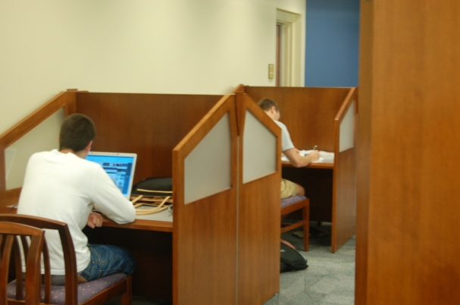
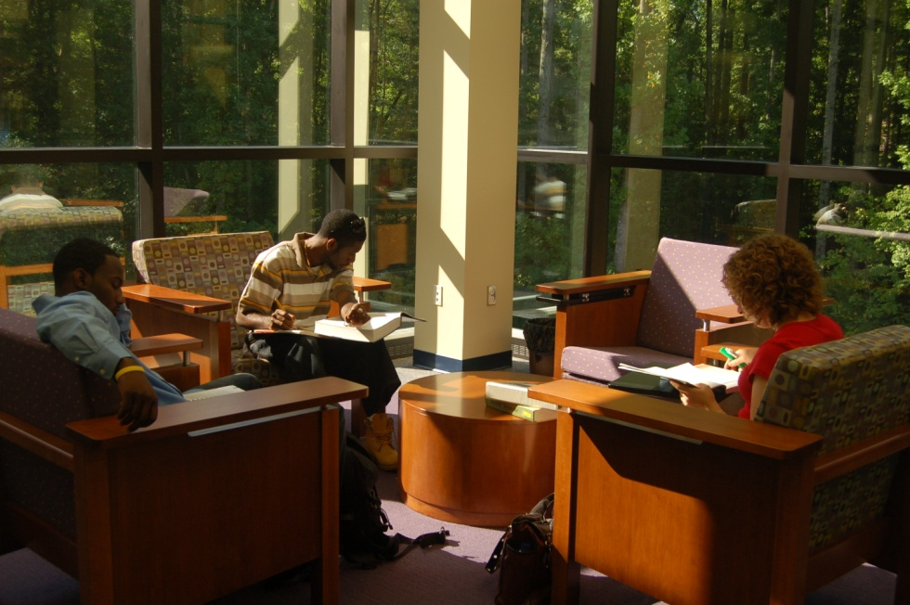
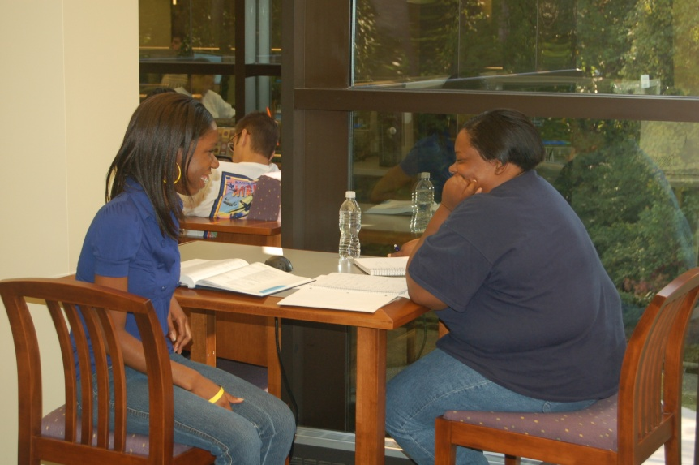
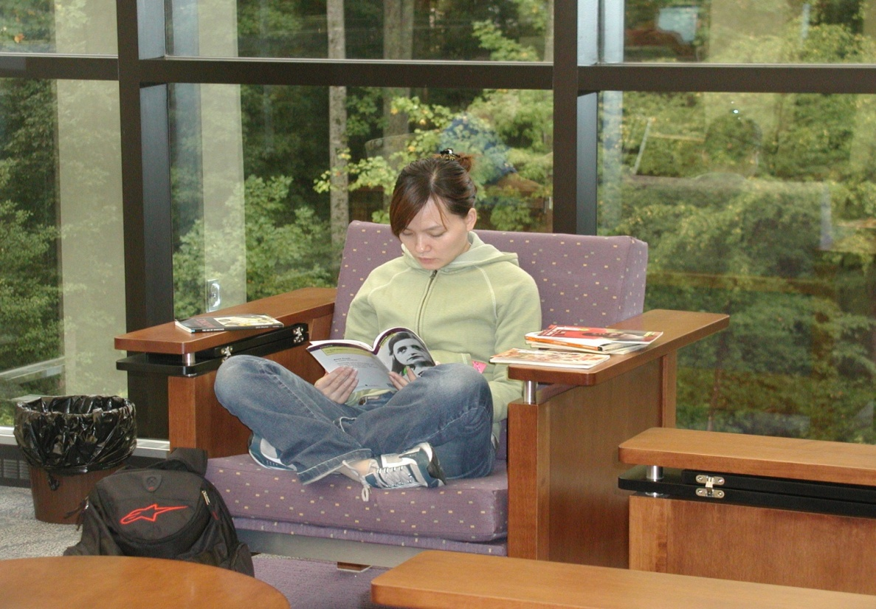
Comfortable: We provide a variety of seating arrangements tailored to both group collaboration or individual study

Slide 6
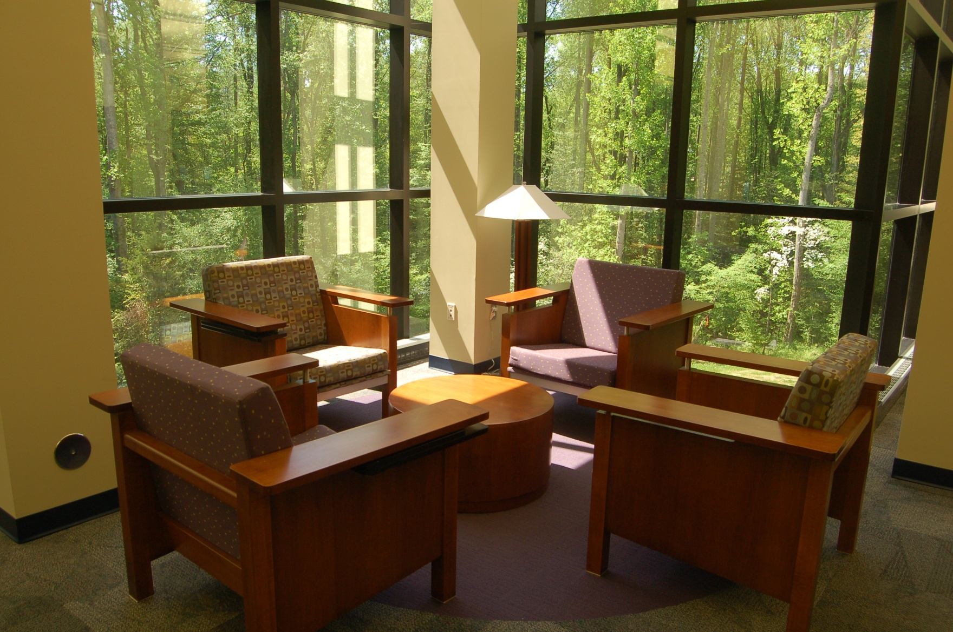
Comfortable: 50 high-back lounge chairs

Slide 7
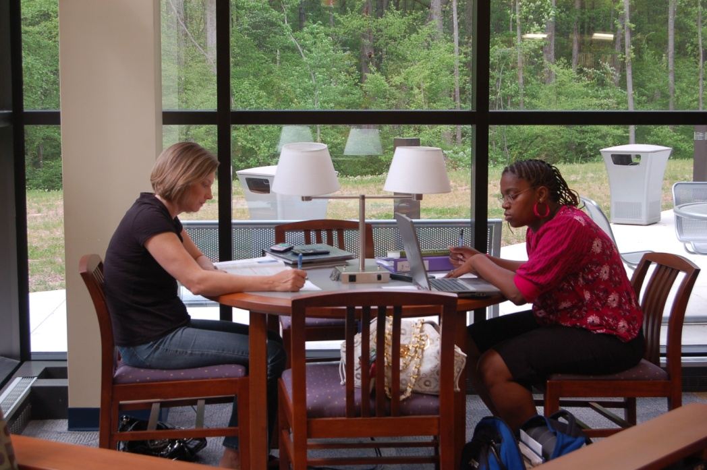
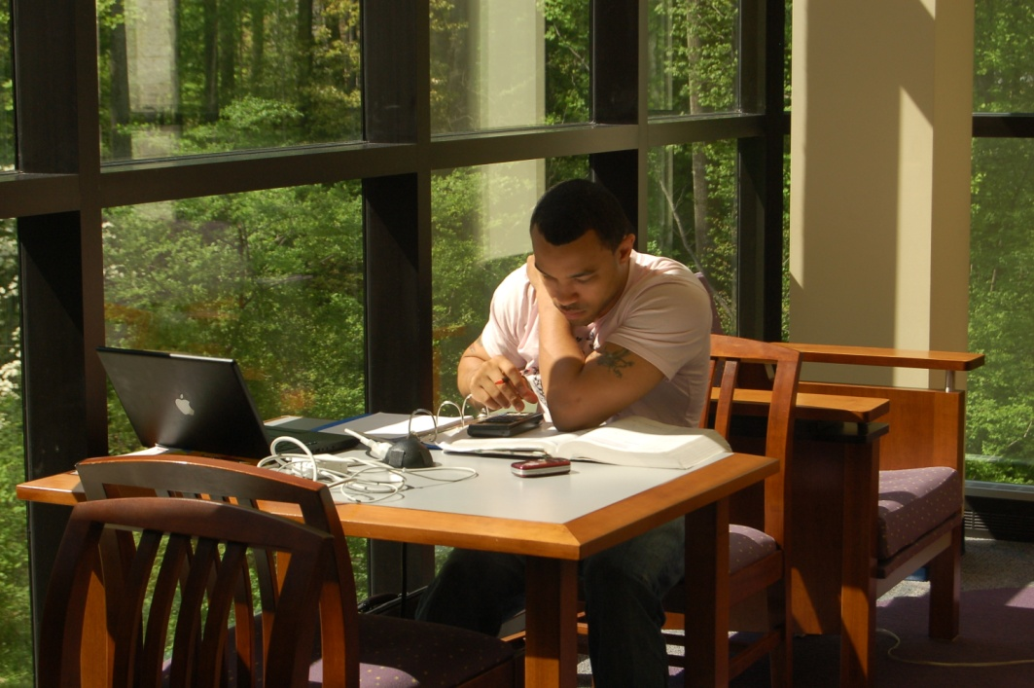
Comfortable: 21 tables for group or individual study

Slide 8
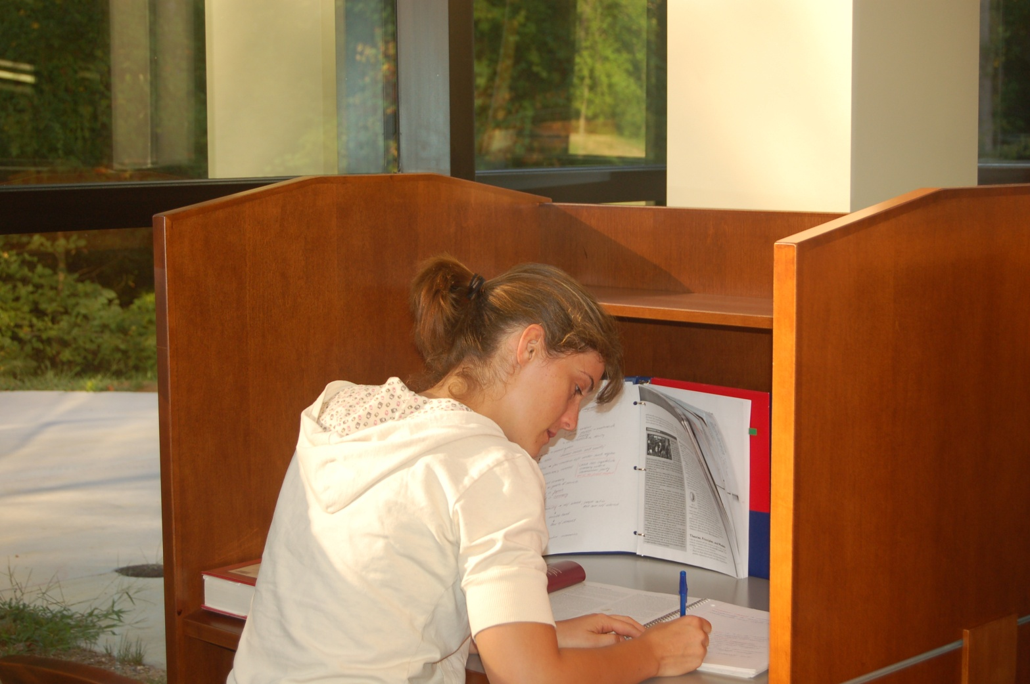
Comfortable: 68 carrels for quiet study

Slide 9
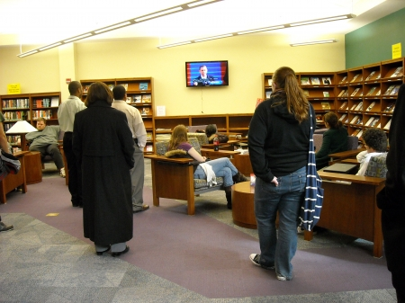
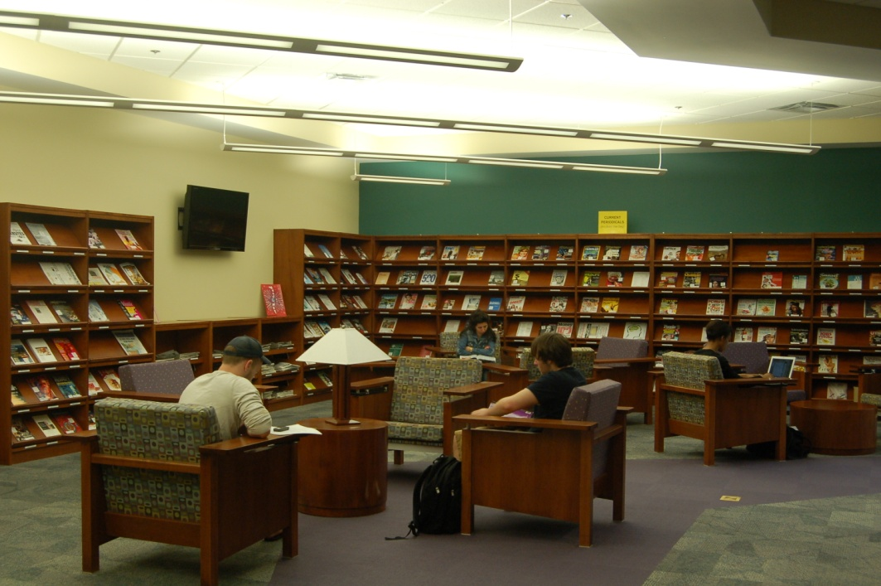
2nd Home: designated area for browsing/entertaining.

Slide 10
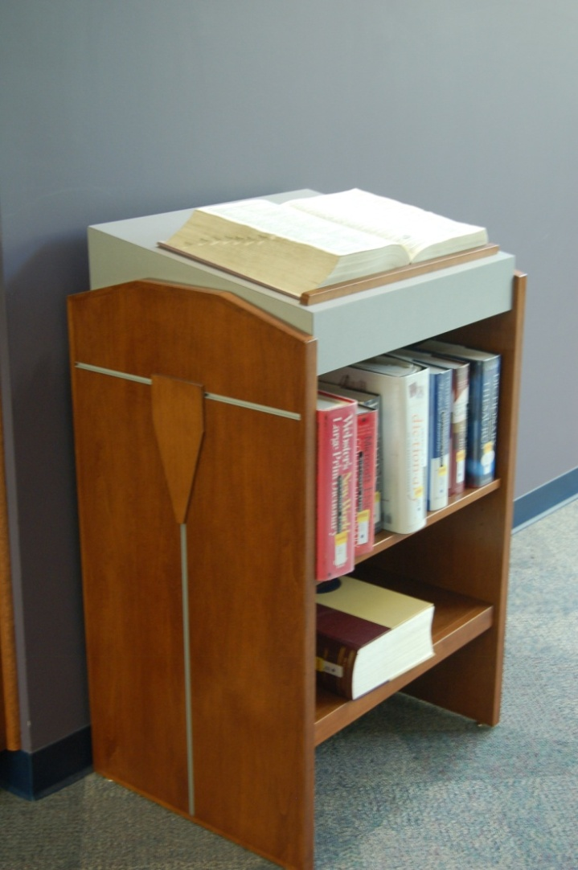
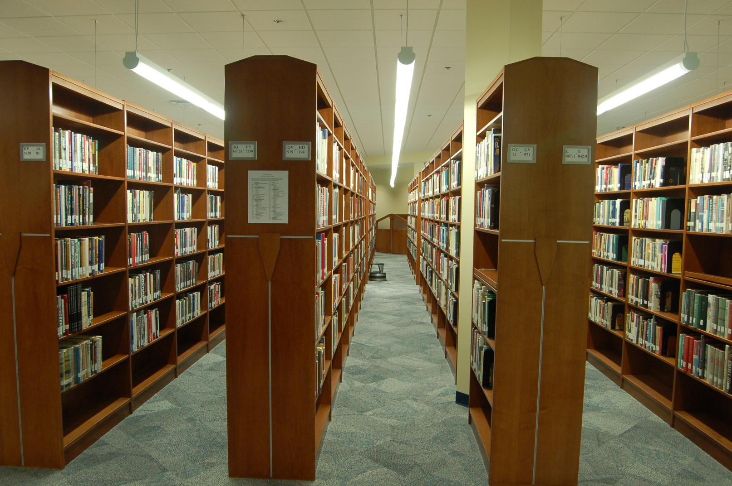
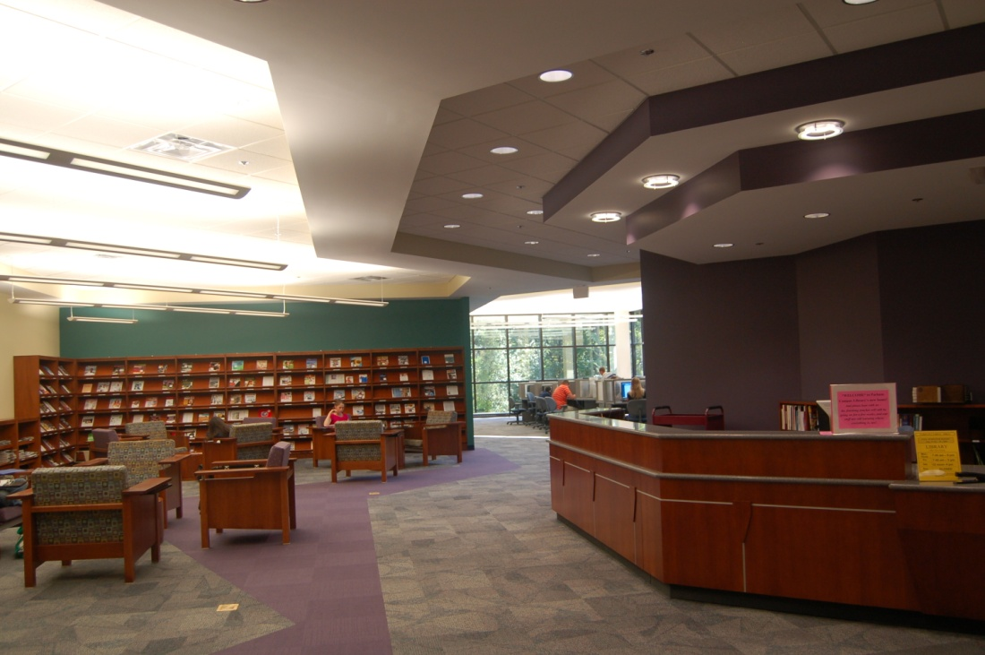
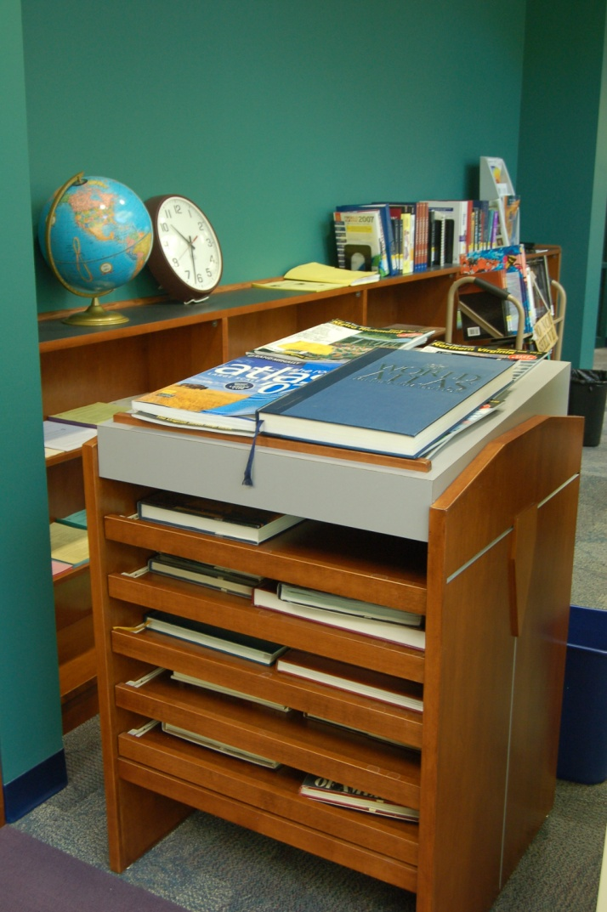
2nd Home: Elegant cherry wood furniture generates the feel of a home study

Slide 11
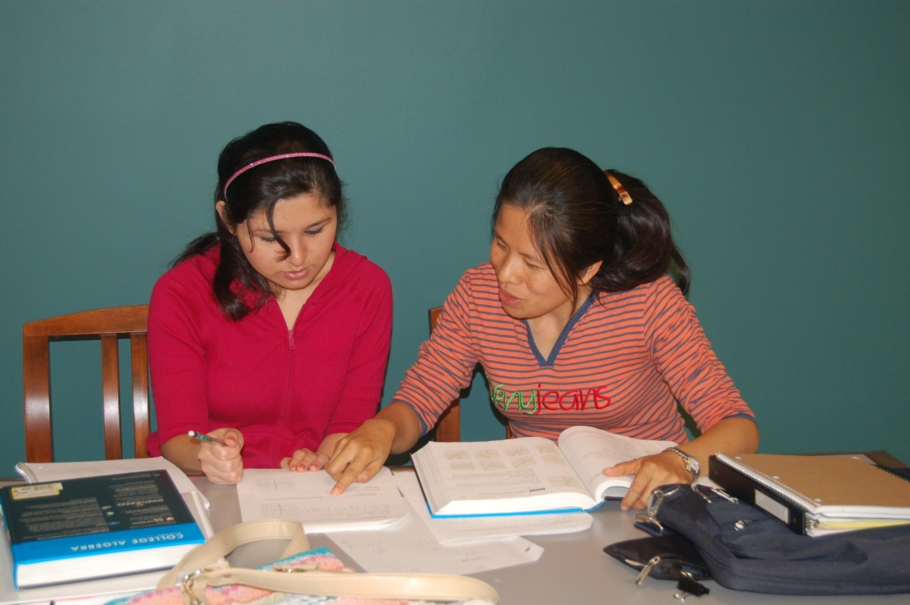
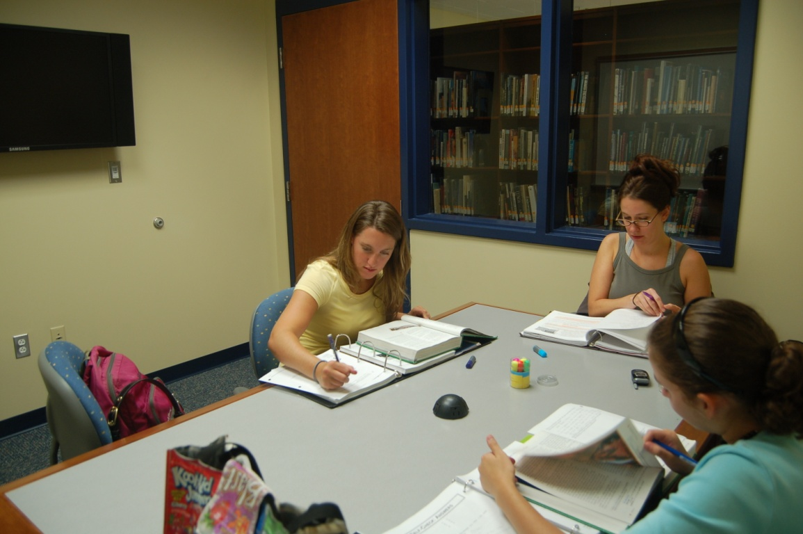
Collaboration: 8 Group Study Rooms

Slide 12
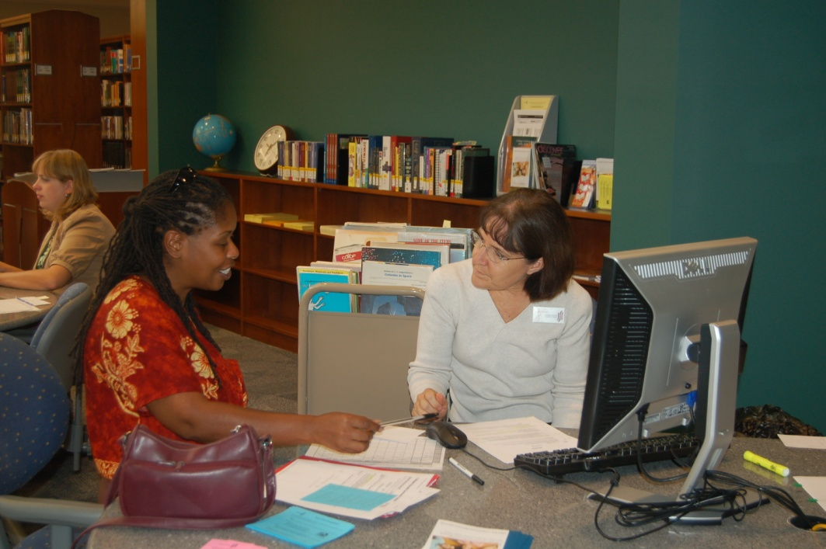
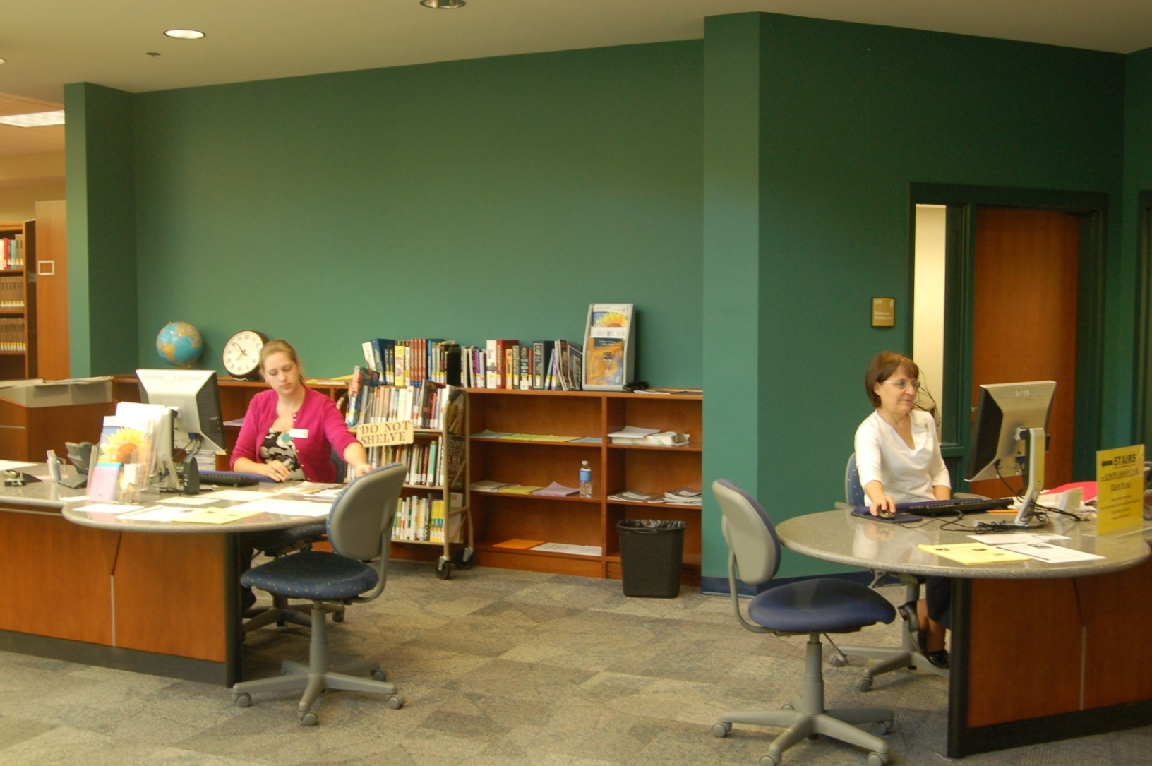
Consultation: Reference/Research area open to encourage consultation

Slide 13
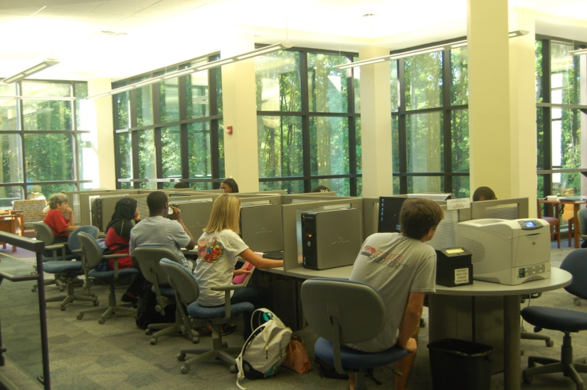
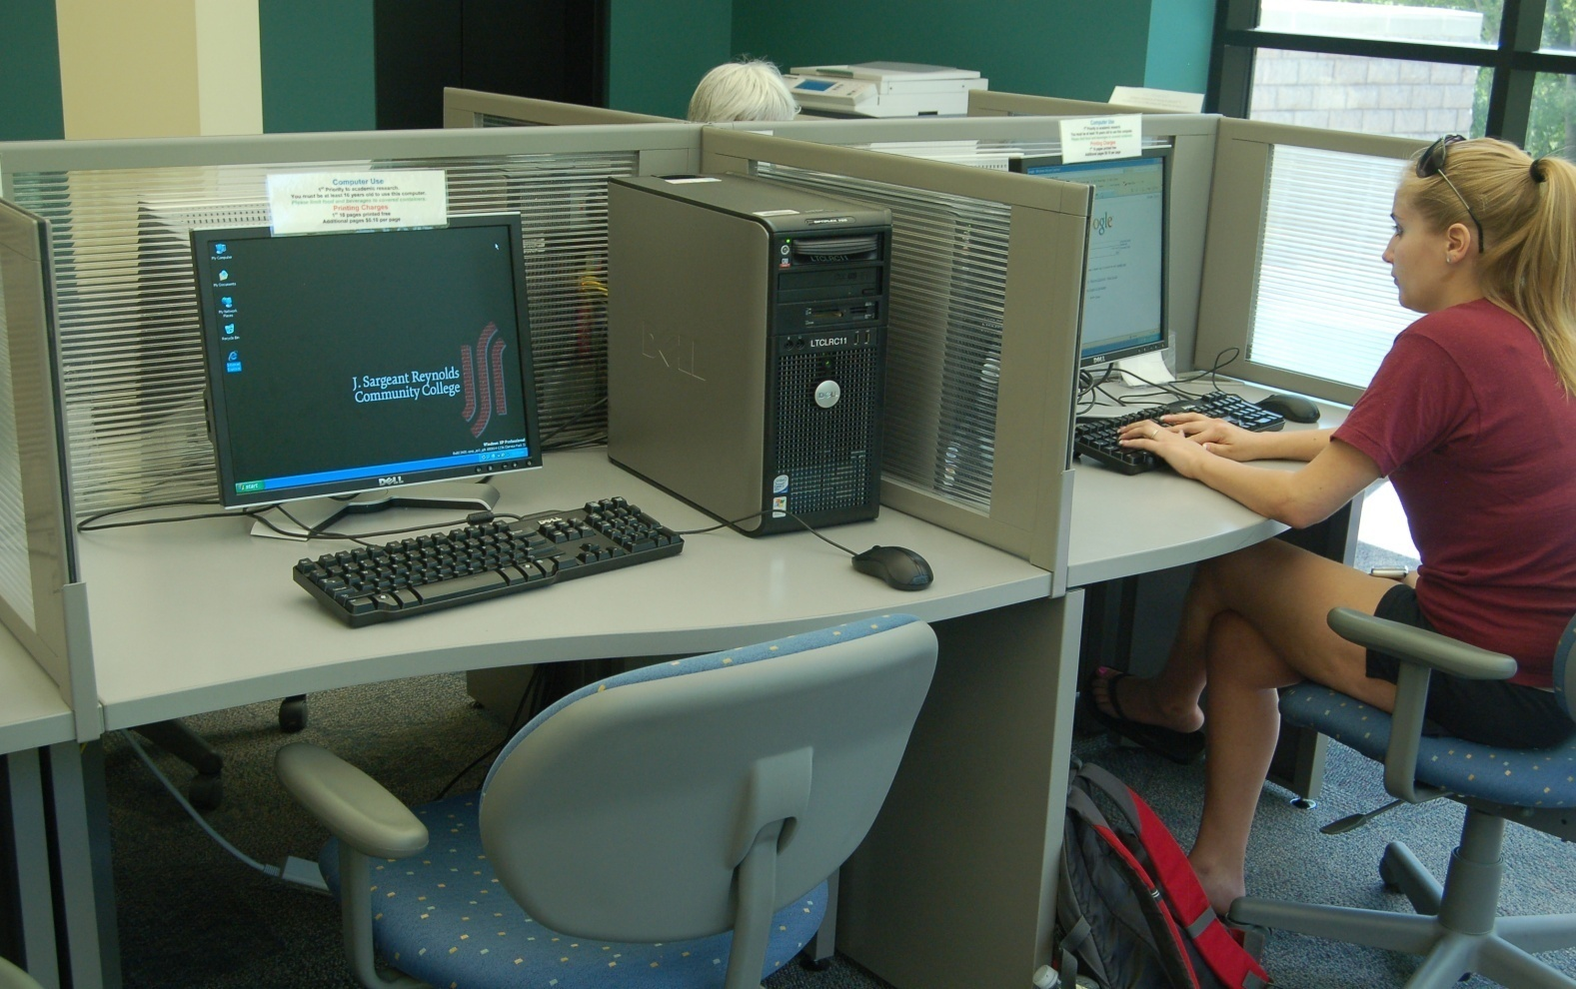
Workstations: Curvy edge & transparent partition to facilitate flow of communication

Slide 14
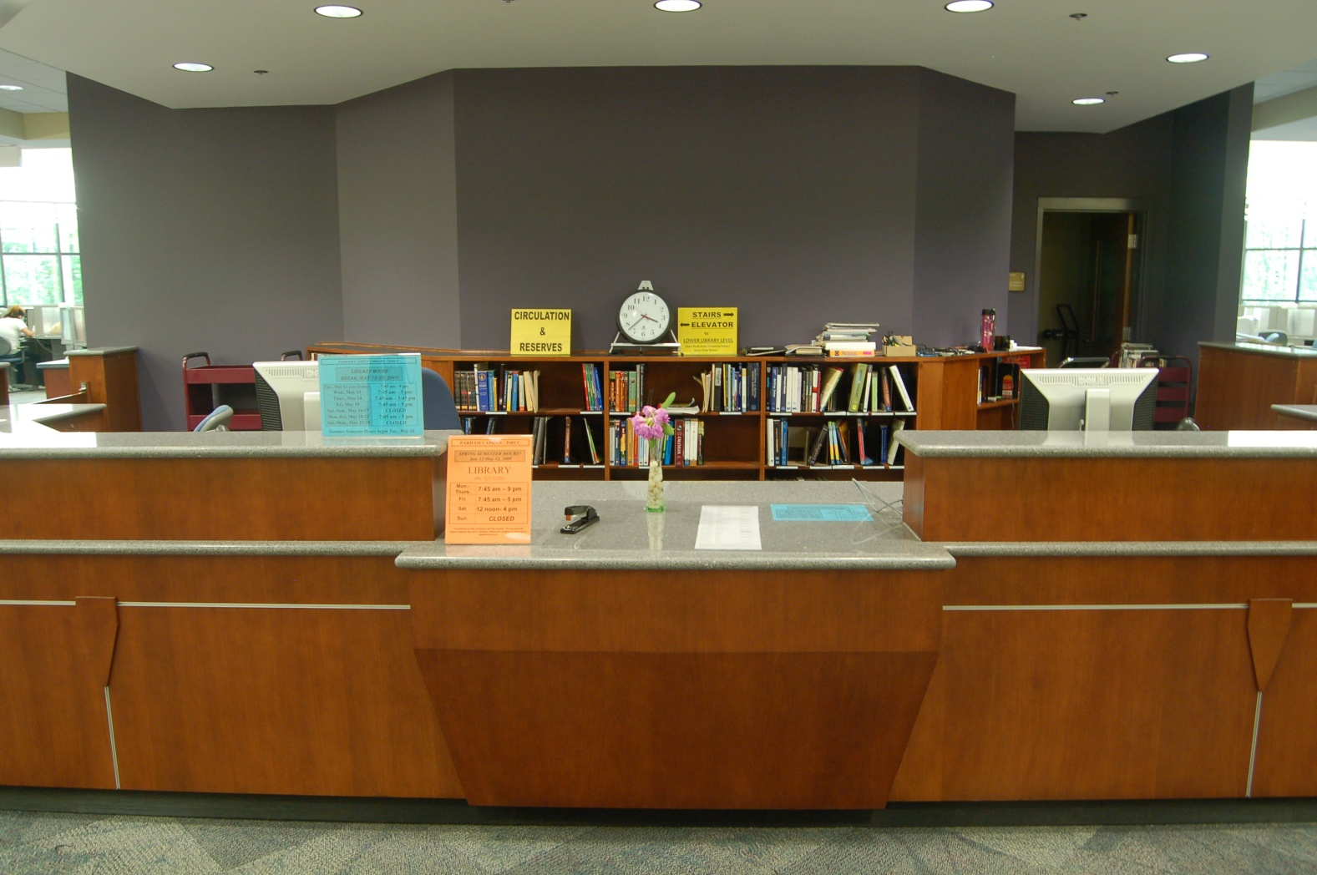
Circulation Area secured, yet accessible

Slide 15
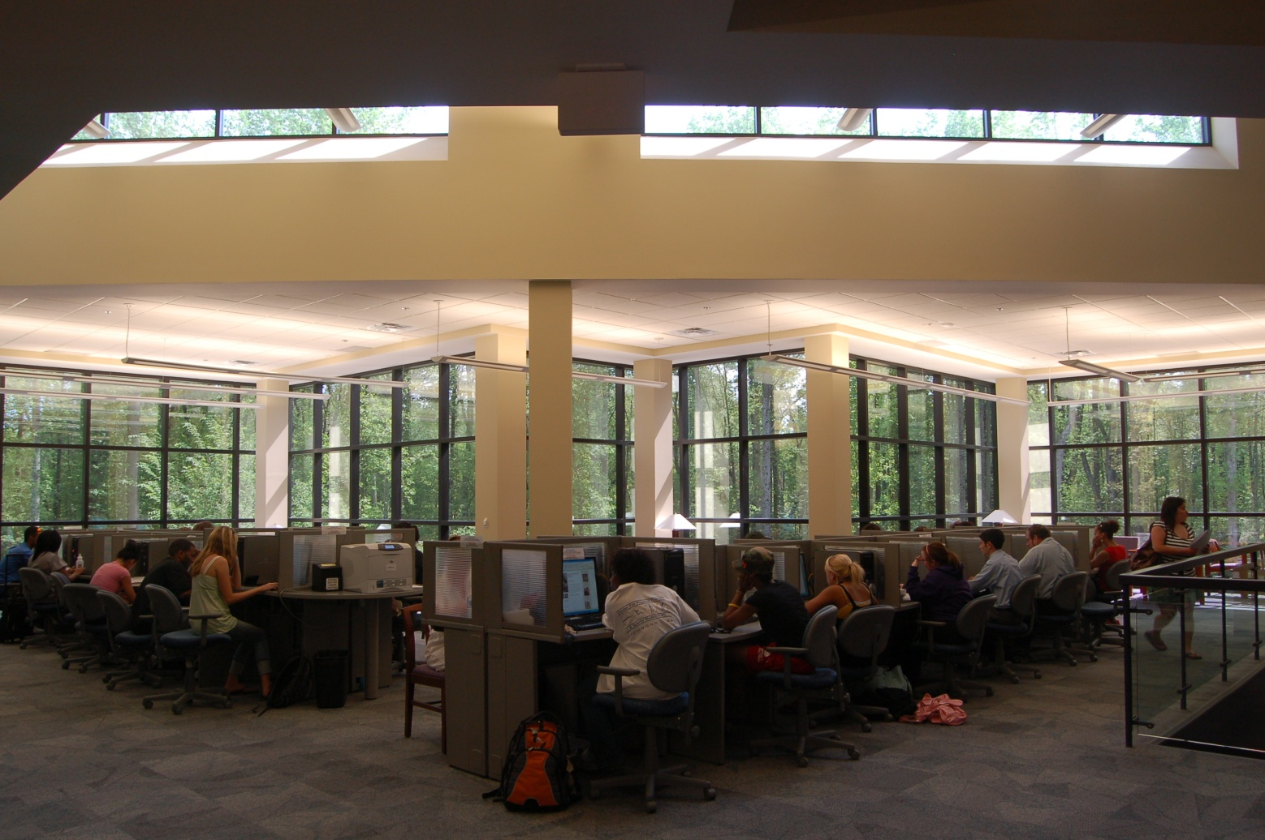
High Tech: 52 high-end computers with access to library databases & MS office

Slide 16
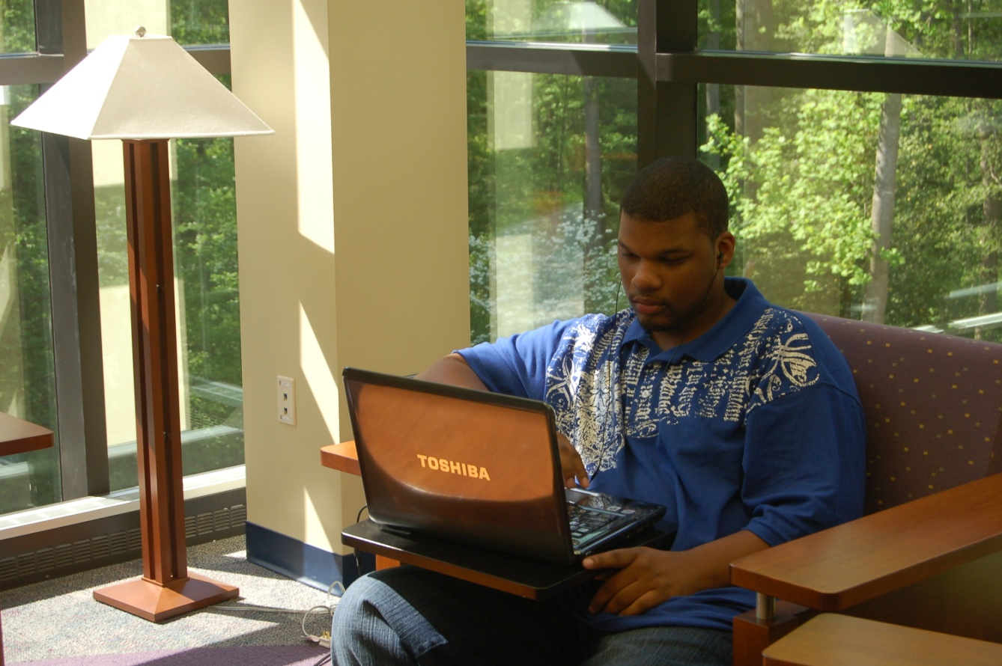
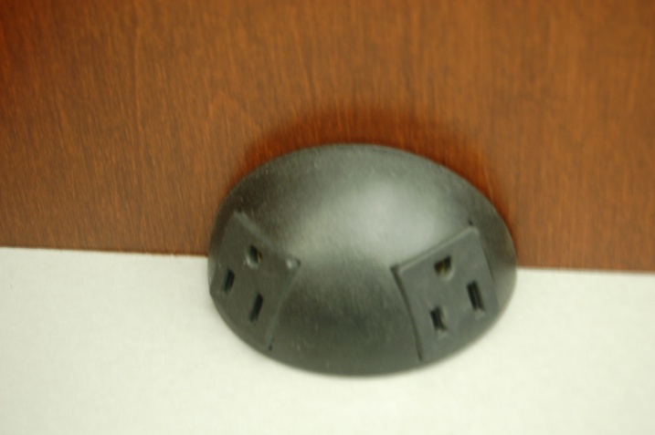
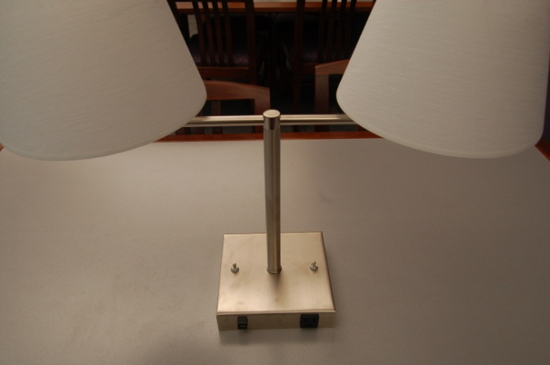
High Tech: Wireless Internet access and receptacles throughout the library

Slide 17
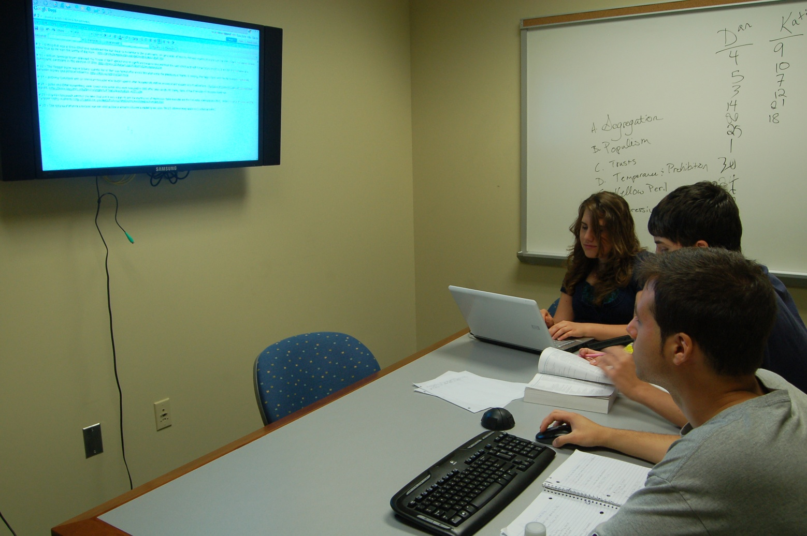
High Tech: Large Flat Screen that serves as a computer or data projector in GSR

Slide 18
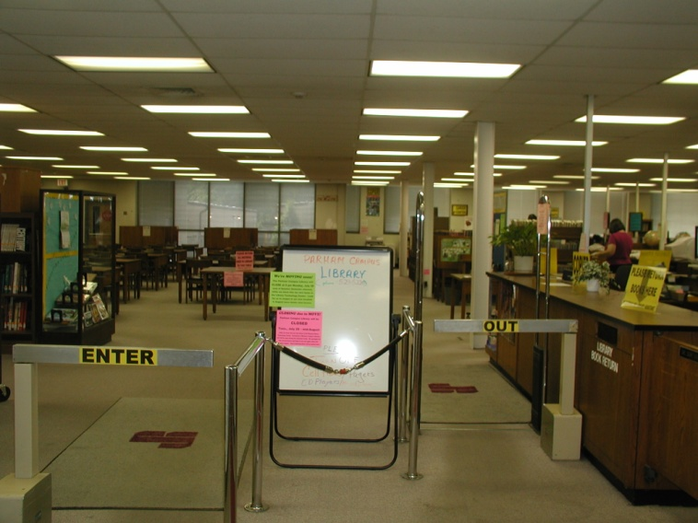
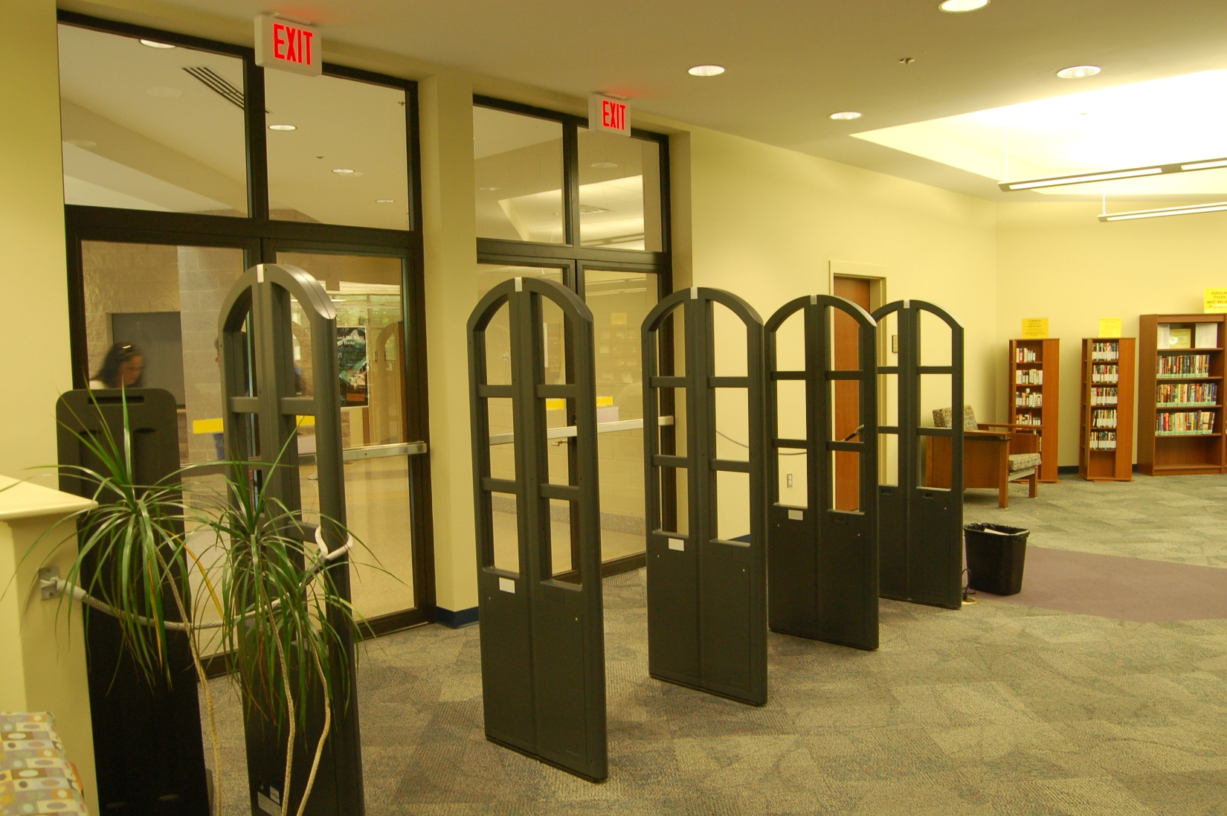
High Tech: The new RFID security system provides un-obstructive passages
Old
New

Slide 19
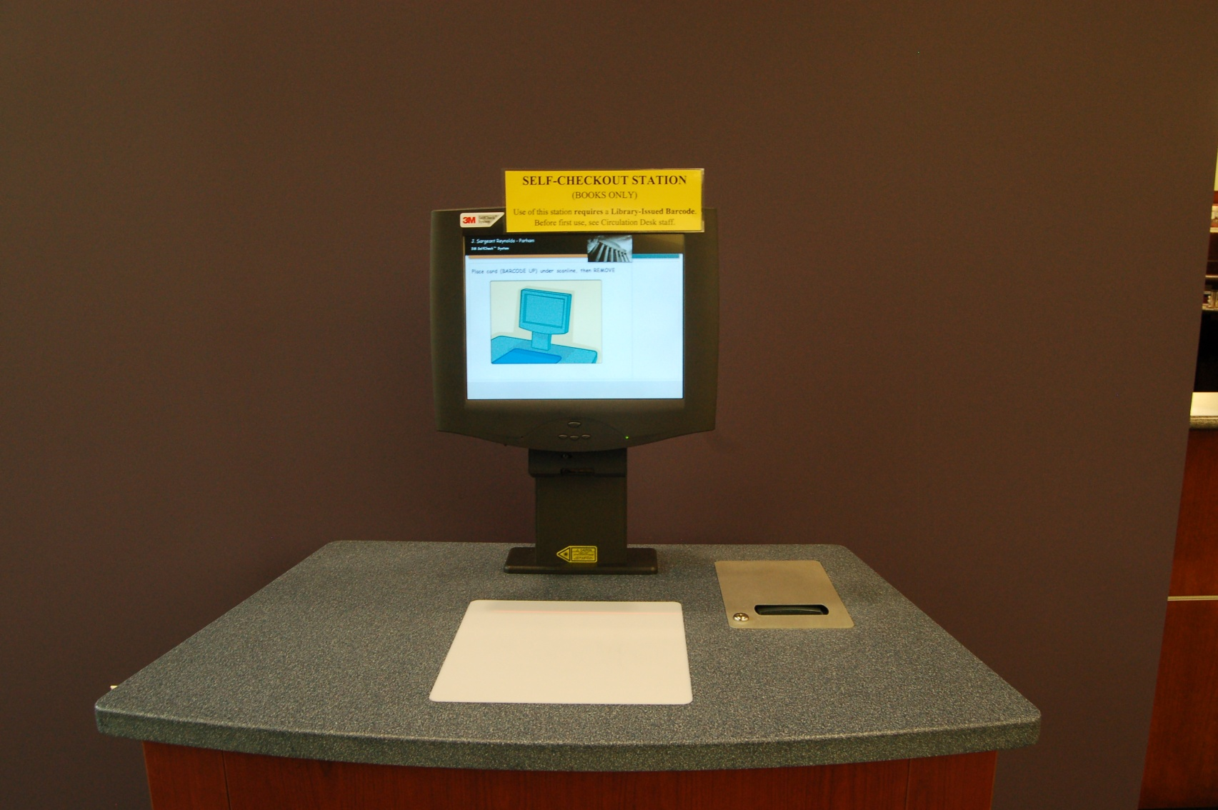
High Tech: 3M Self-checkout

Slide 20
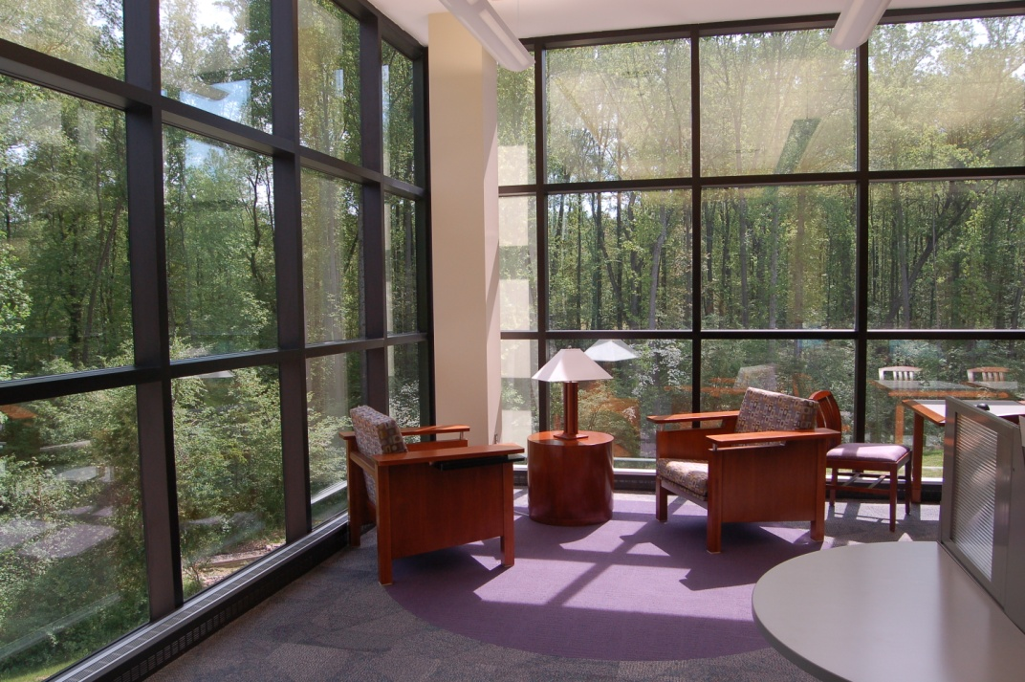
Design: Carpet patterns and colors to guide traffic flow

Slide 21
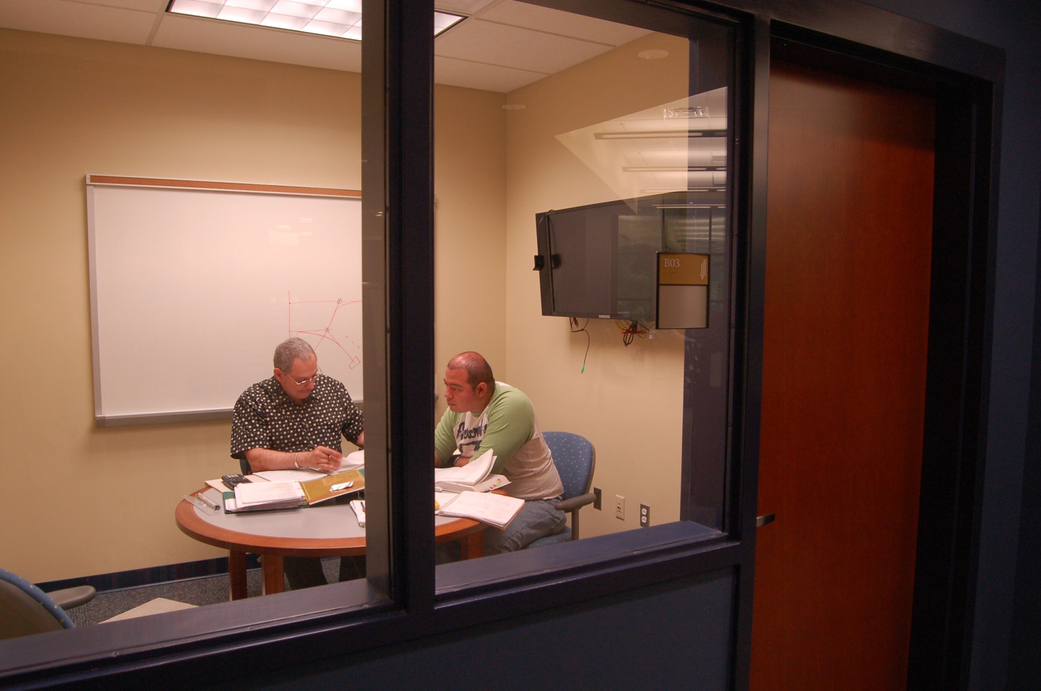
Details: Large glass window on Group Study Room

Slide 22
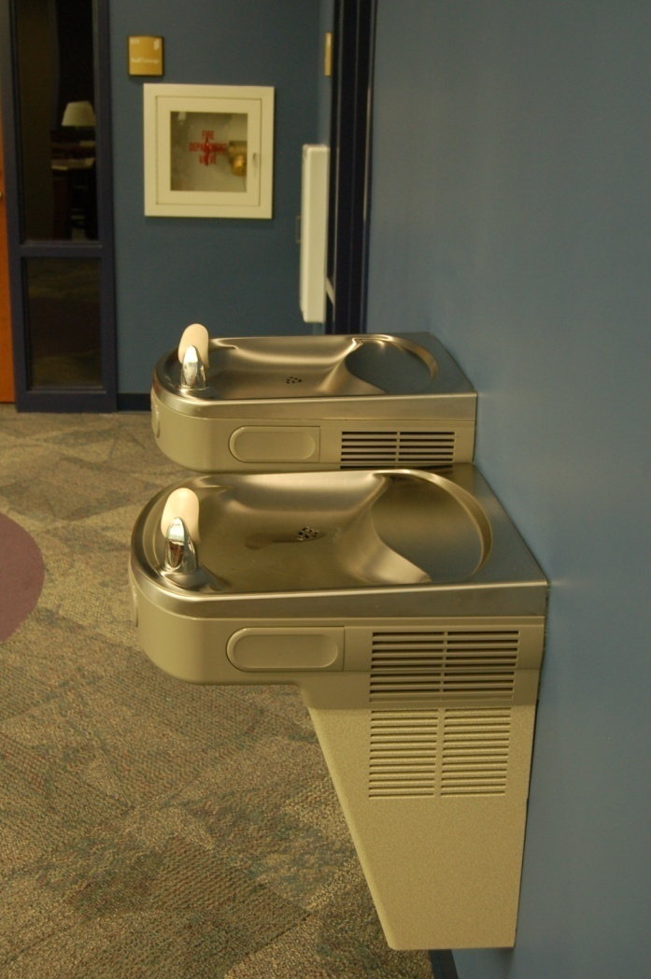
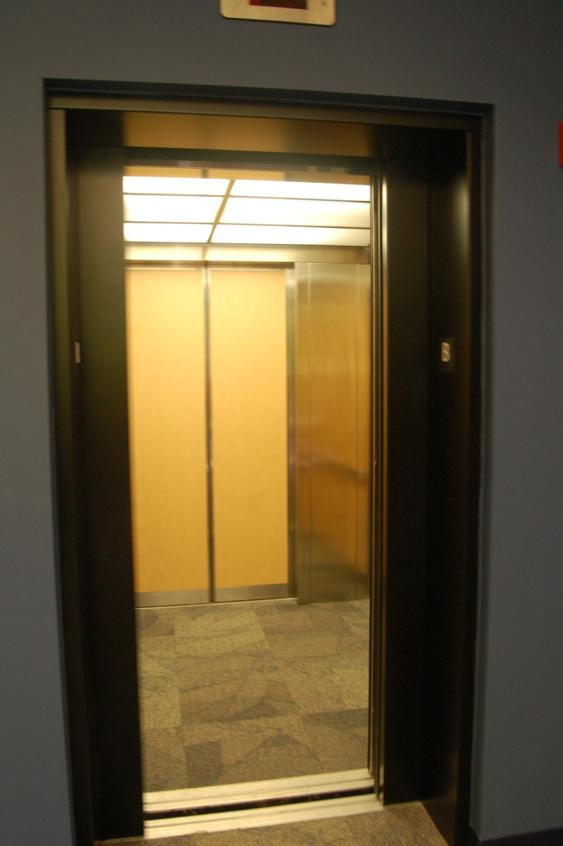
Details: Drinking fountain & elevator inside library

Slide 23
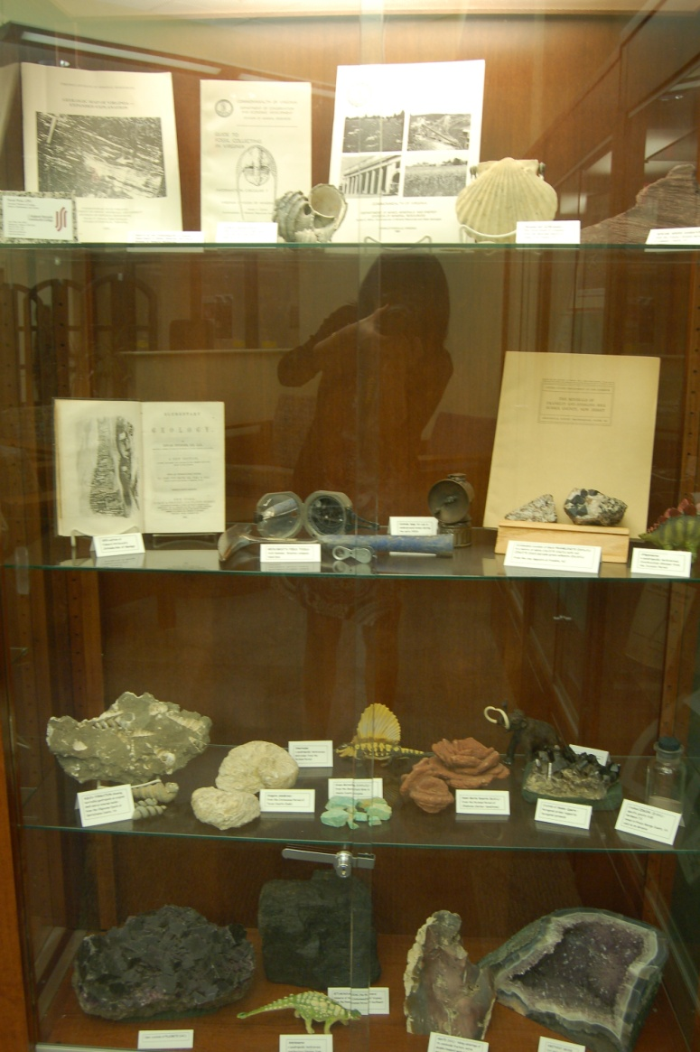
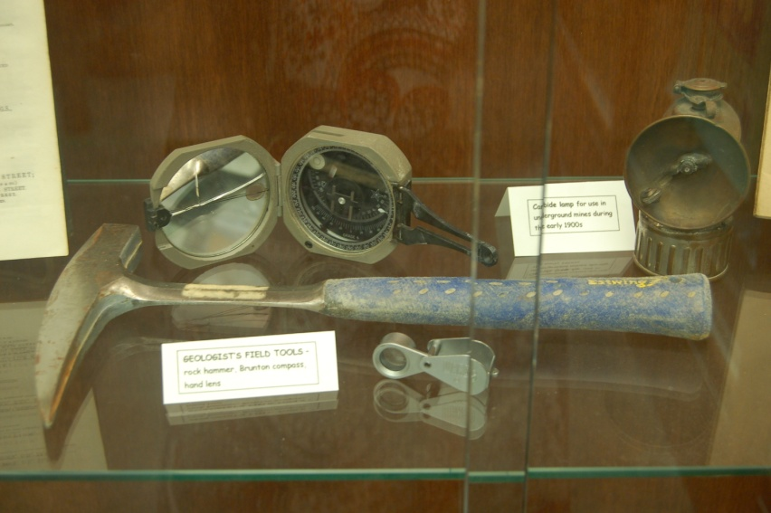
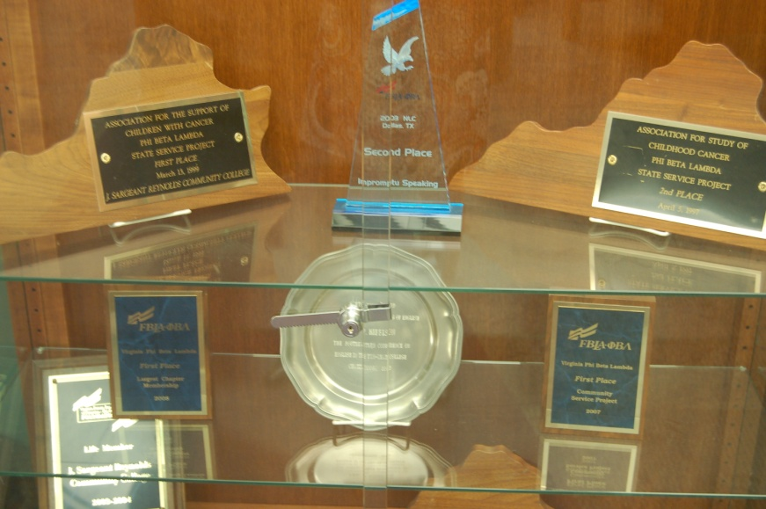
Loan exhibit shelves to faculty and students

Slide 24
Statistics showed that the number of library visitors doubled during the first 6 months
Gatecount Before Opening: 63, 854 Gatecount After Opening: 121,390

Slide 25
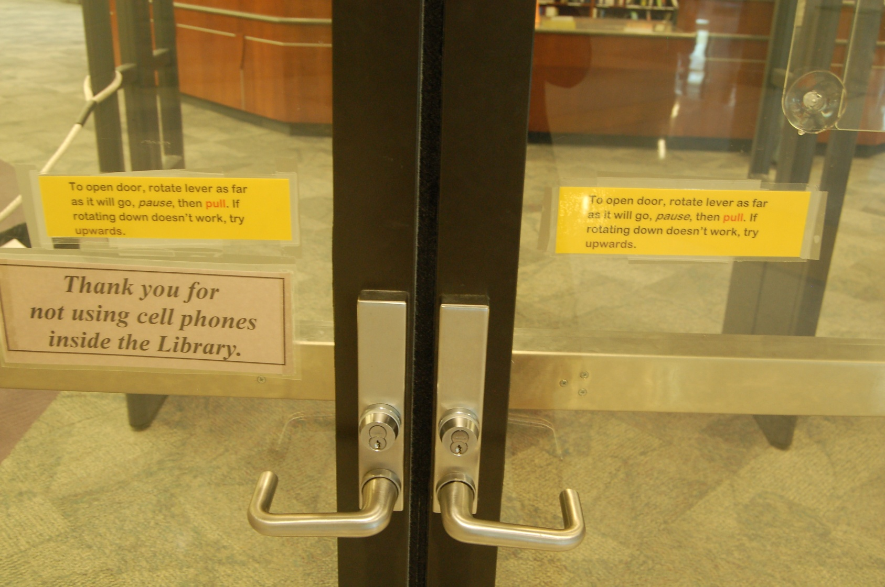
Lessons Learned: ADA Compliant

Slide 26
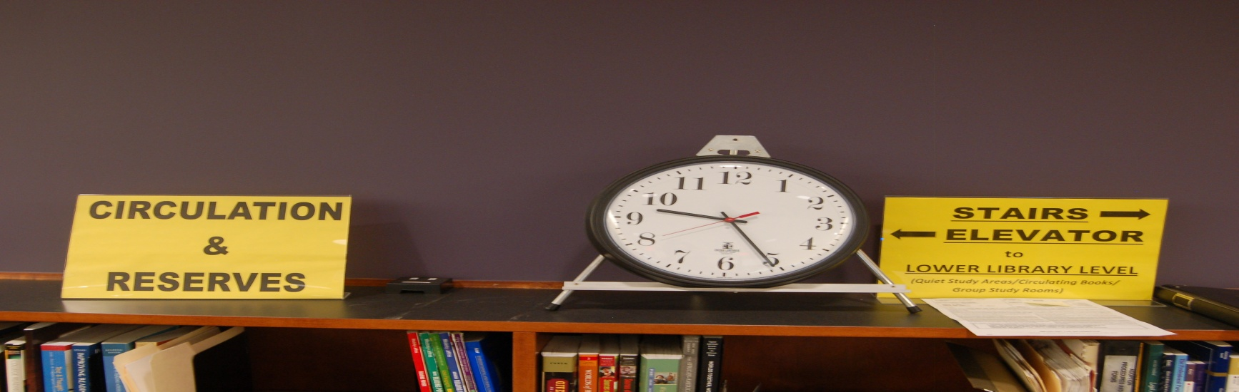
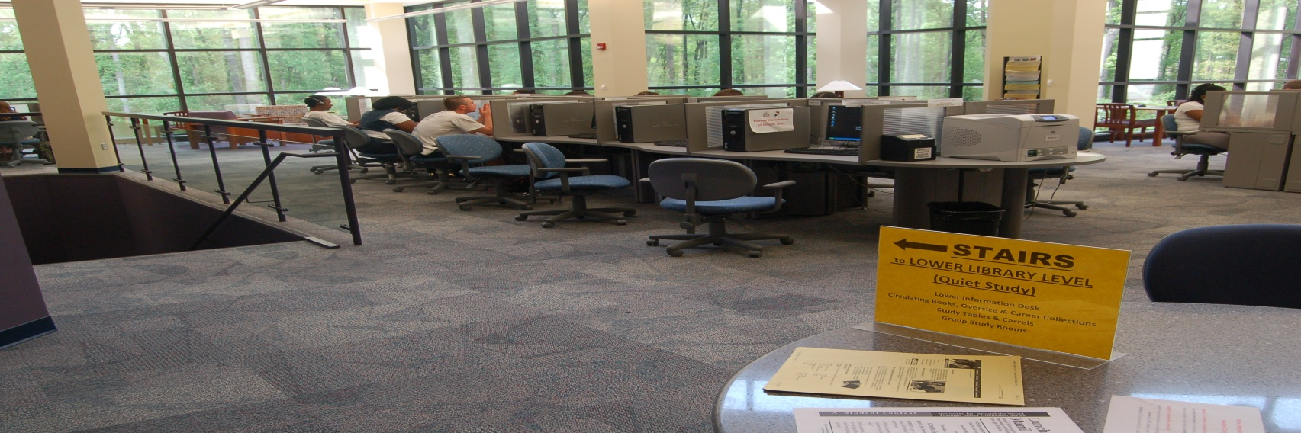
Lessons Learned: Signage

Slide 27
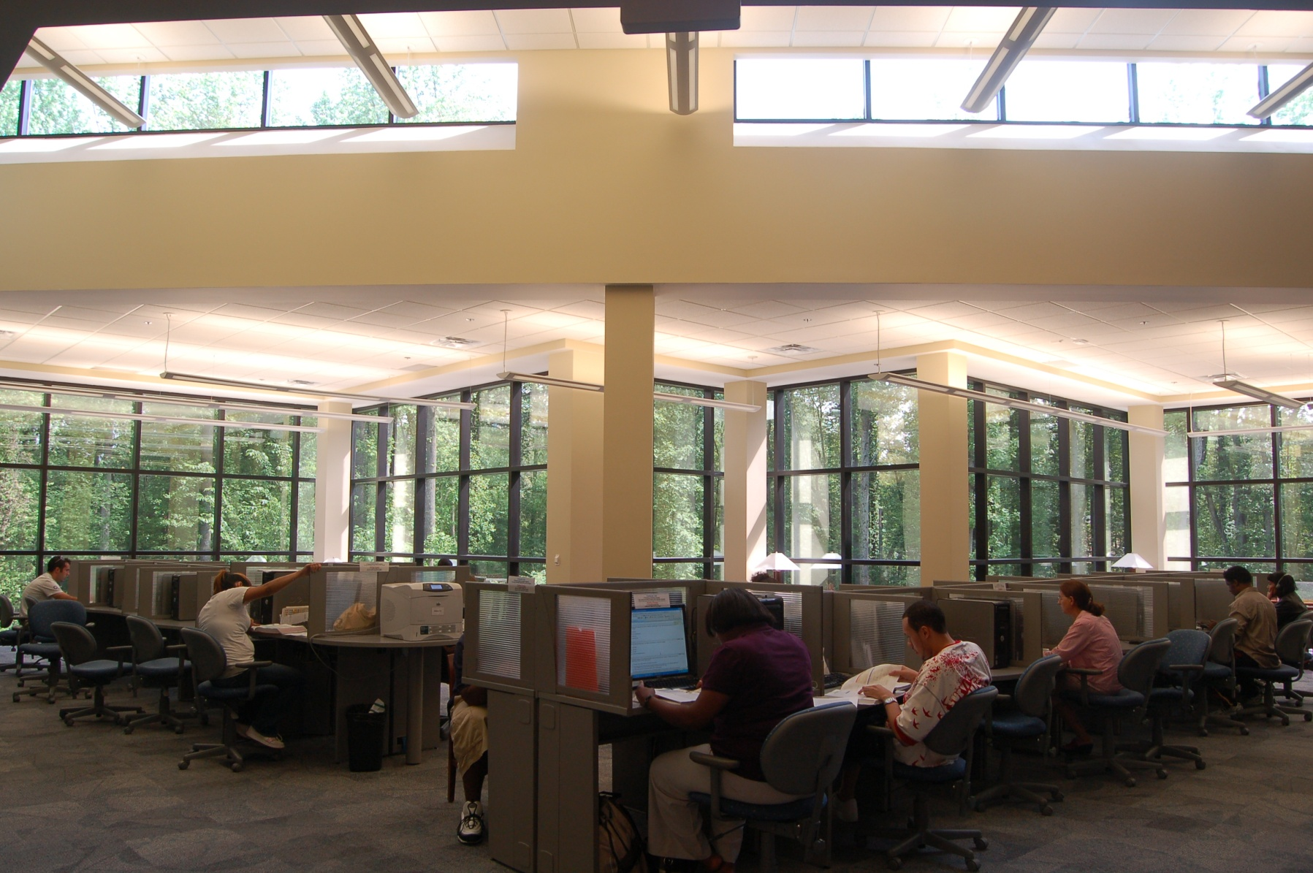
Lessons Learned: Sun glare

Slide 28
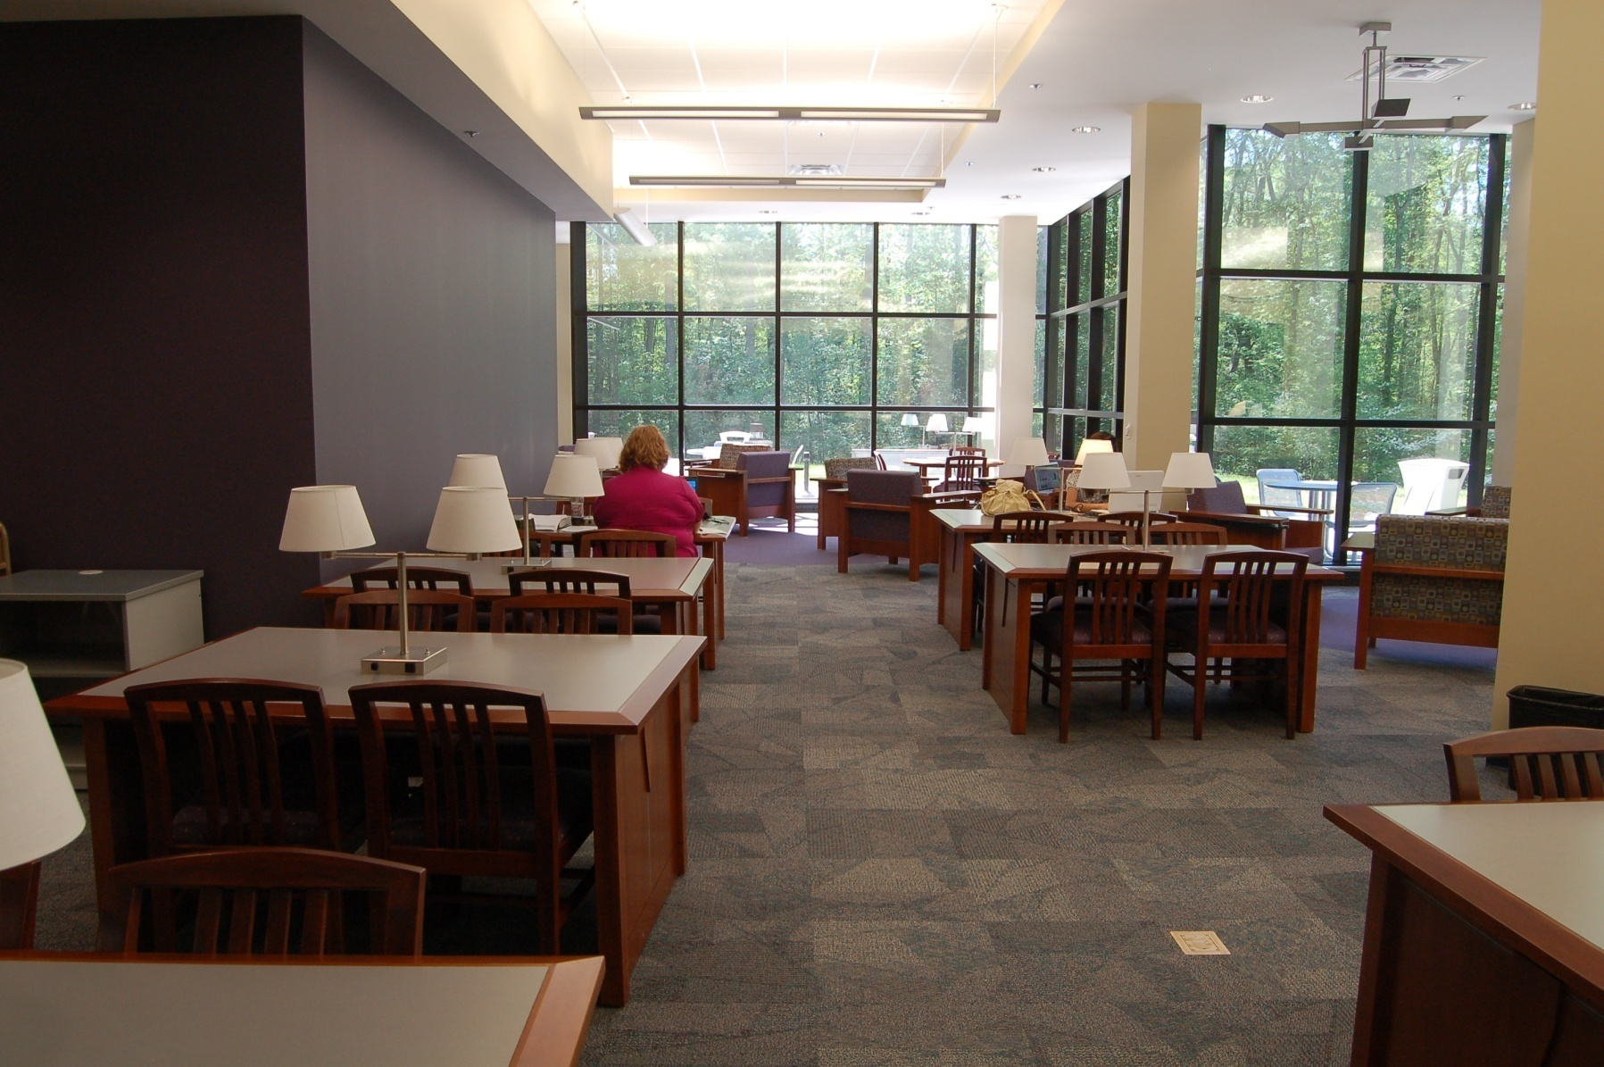
Lessons Learned: More electrical outlets please

Slide 29
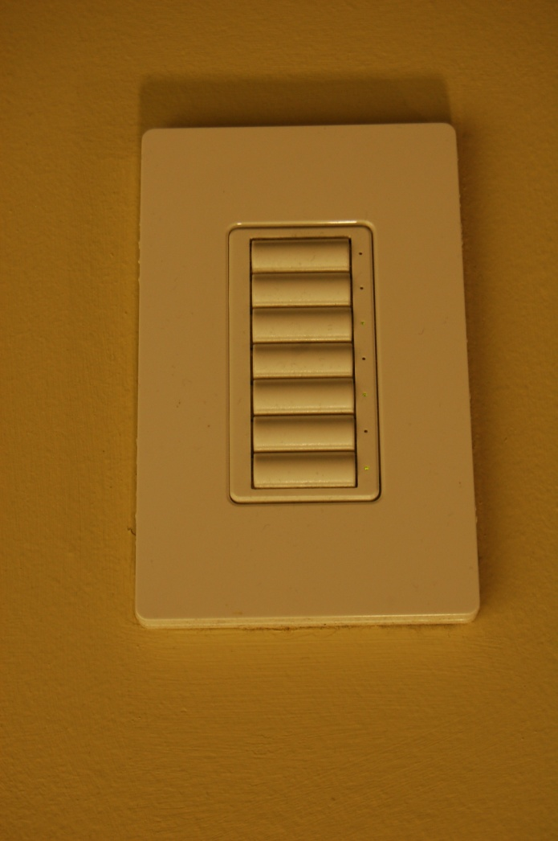
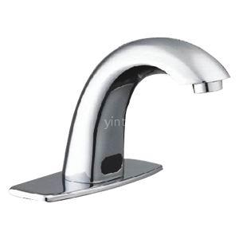
Lessons Learned: Be cautious about automatic devices

Slide 30
Lessons Learned: Secured Staff Complex

Slide 31
Best Practices Learned: Planning: (College Level)
Being involved at the college level planning from the beginning
Know your power structure
Form alliances with your potential partners
Aggressively sell your innovative library programs to people in power

Slide 32
Planning (Internal)
Form a taskforce
Conduct need assessment
Determine project scope and vision
Open discussion and debate among all staff
Reach consensus & prepare preliminary plan
Share and sell your plan college-wide

Slide 33
Identifying Student Needs
Social space vs. Quiet space
High Tech for net generation
Access to expert assistance
One-stop-shop
Comfort (leisure space, comfortable seating, food and drinks)

Slide 34
Space Planning
Spaces must to have, nice to have, can do without
Activities engaged in spaces
Prepare an inventory of space needs, furniture needs, and equipment & technology infrastructure
Provision for enough lighting, power, & data to remain flexible
Identify vendors to prepare specs

Slide 35
Collecting Information
Visit new libraries
Attend Conferences
Conduct research
Seek assistance from colleagues
Hire consultants (if possible)

